Slide 1
SCM (Software Management Configuration Process) System Configuration Management (SCM) is an arrangement of exercises which controls change by recognizing the items for change, setting up connections between those things, making/characterizing instruments for overseeing diverse variants, controlling the changes being executed in the current framework, inspecting and revealing/reporting on the changes made. It is essential to control the changes in light of the fact that if the changes are not checked legitimately then they may wind up undermining a well-run programming. In this way, SCM is a fundamental piece of all project management activities.

Slide 2
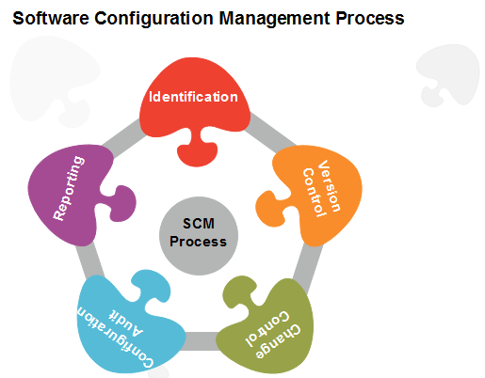
Scm process
The SCM process defines a number of tasks:
Identification of objects in the software configuration
Version Control
Change Control
Configuration Audit
Status Reporting

Slide 3
Identification-Identifying the configuration items from products that compose baselines at given points in time (a baseline is a set of mutually consistent Configuration Items, which has been formally reviewed. Version control-Creating versions/specifications of the existing product to build new products . Configuration Auditing- A software configuration audit complements the formal technical review of the process and product. It focuses on the technical correctness of the configuration object that has been modified. Change Control- Change control is a procedural method which ensures quality and consistency when changes are made in the configuration object. In this step, the change request is submitted to software configuration manager. Reporting-Providing accurate status and current configuration data to developers, tester, end users, customers and stakeholders through admin guides, user guides, FAQs, Release notes, Memos, Installation Guide, Configuration guide etc .

